Slide 1

Hello!
I am Arshak Rezvani
You can find me at @ArshakRz

Slide 2

Comparison of Multi-Channel EEG Based Graph Learning Methods
Supervisor: Dr. Mohammad B. Shamsollahi
#WomanLifeLiberty

Slide 3
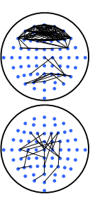
What I Want To Do? [4]

Slide 4
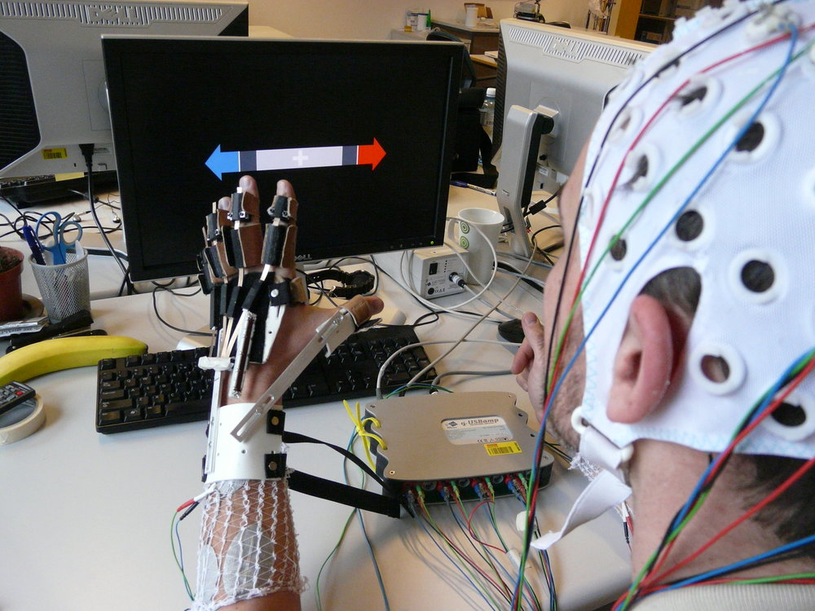
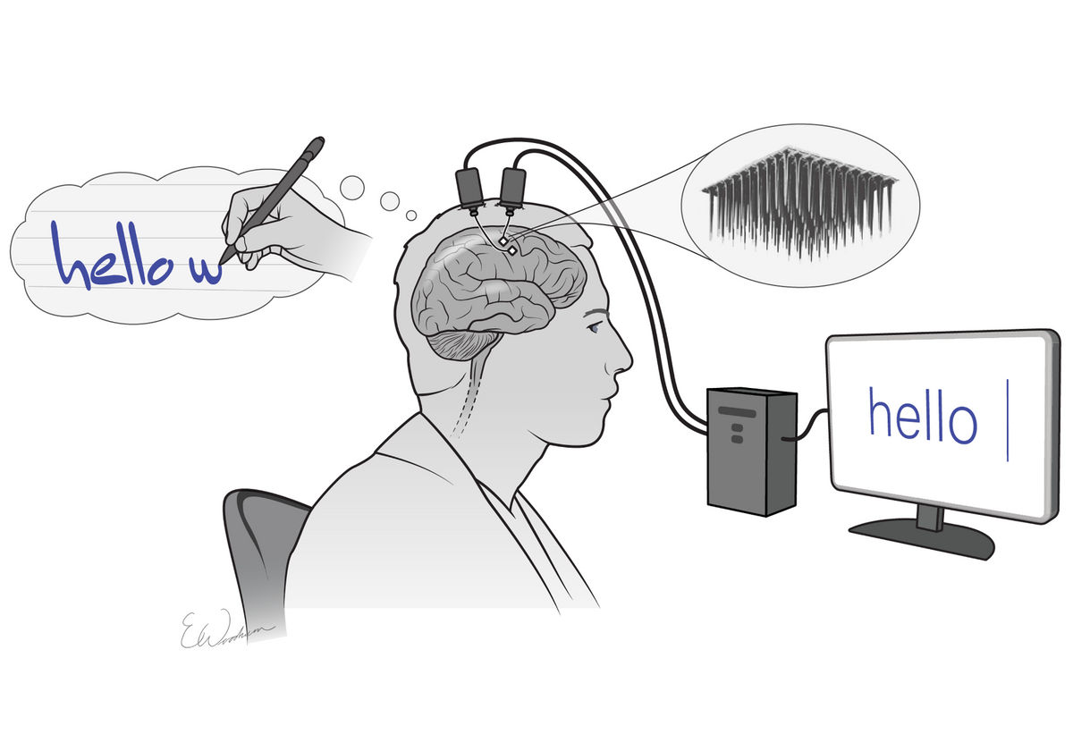
Why? [1]

Slide 5
Data Set
Two Class:
Imagining Moving Foot
Doing Math
10-20 Recording System
165 Trials
30 Channels
AFz, F7, F3, Fz, F4, F8, FC3, FCz, FC4, T7, C3, Cz, C4, T8, CP3, CPz, CP4, P7, P5, P3, P1, Pz, P2, P4, P6, P8, PO3, PO4, O1, and O2.
256 Points
256 Hz
Notch Filter 50 Hz
Bandpass [0.5 100] Hz
ICA

Slide 6
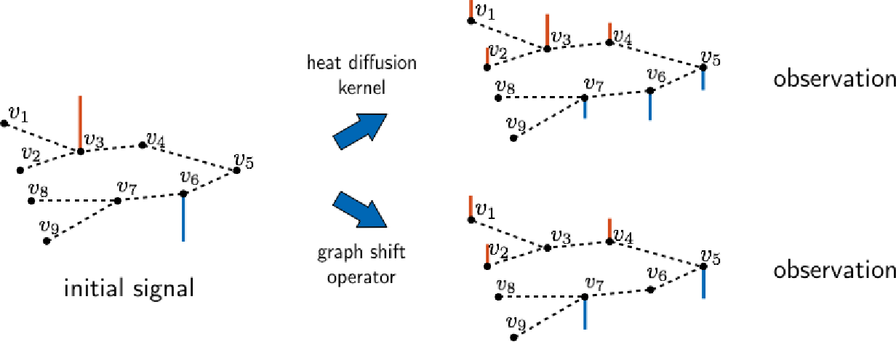
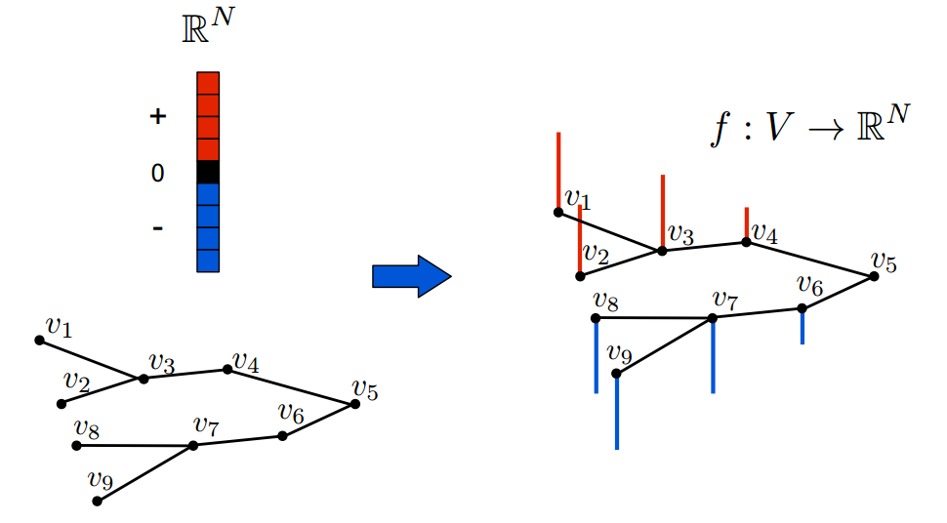
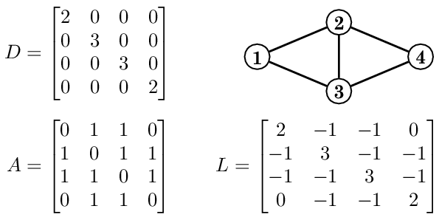
But What is a Graph Signal?
Graph Representations
Adjacency Matrix
Laplacian Matrix
A Vector on a Graph!
It is a Signal
Graph Shift
Graph Fourier Transform(GDFT)
Graph Filtering and Convolution
Initial Signal
Shifted Signal

Slide 7
There Are Three Approaches
One by One
Optimization Problem
Morphological Approach

Slide 8
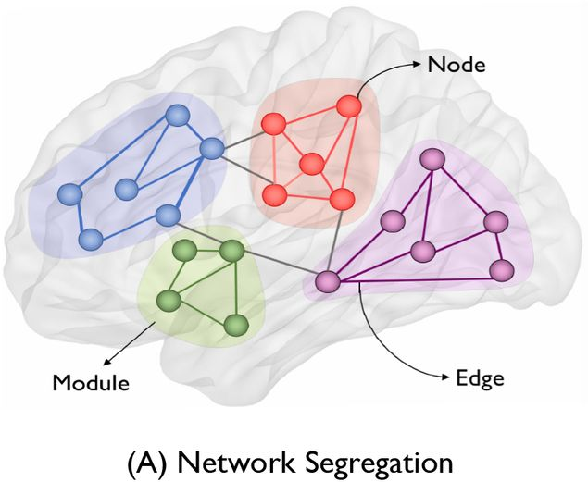
Estimating Functional Connectivity Of Two Electrode Time Series [3]

Slide 9
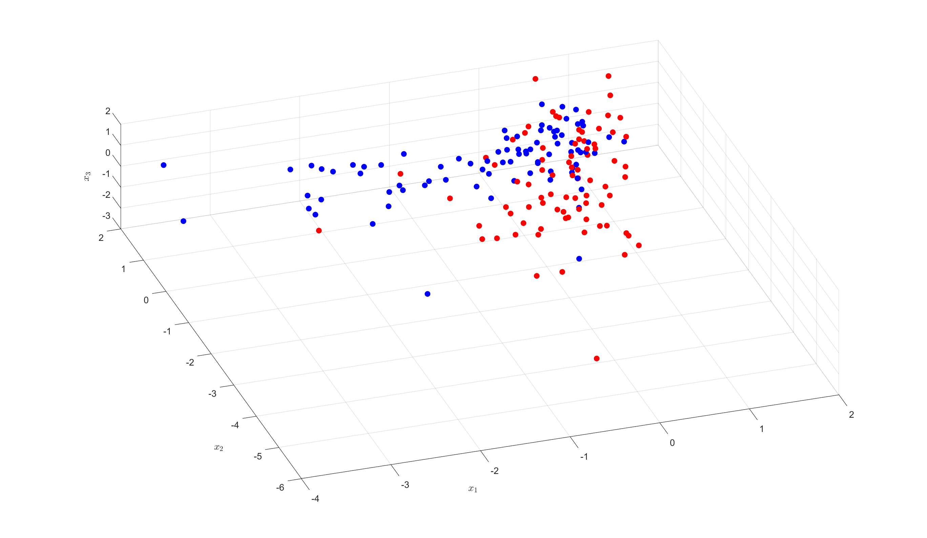
Results
Correlation between channels
Features:
Weights
Graph Frequencies (Eigen Values of Laplacian)
465 features
Chose 10 using mRMR
Classifier:
AdaBoost

Slide 10
Learning Graphs From A Smooth Signal [4]
How to quantify how smooth a set of vectors are on a given weighted undirected graph? (Smooth Definition)
$$\min_{W∈𝒲_{m}}{{\left|\left|W∘Z\right|\right|}_{1,1}}−α1^{T}\log\left(W1\right)+\frac{β}{2}{\left|\left|W\right|\right|}_{F}^{2}$$

Slide 11
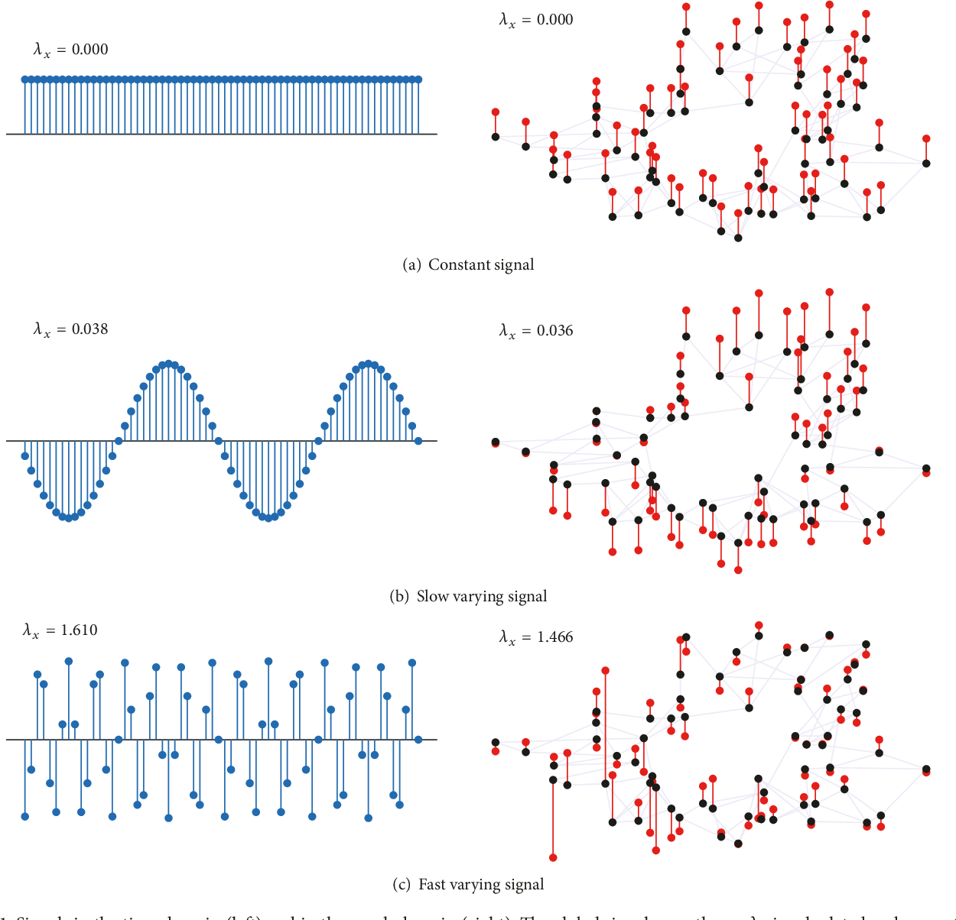

Slide 12
Results (Distance Of Times Series For Z)

Slide 13
Results
Used Distance Of Times Series For Z
Features:
Weights
Graph Frequencies (Eigen Values of Laplacian)
465 features
Chose 10 using mRMR
Classifier:
AdaBoost

Slide 14
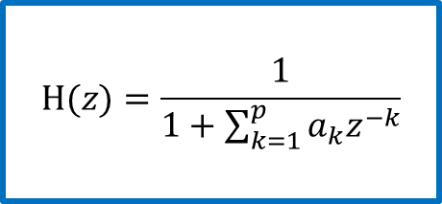
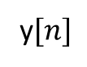
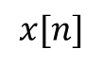
Embedding Algorithm [1]
Used The Euclidian Distance Between Channels
The Number of Time Samples (T) Is Very High
Smoothness Cannot Be Coded
Embedding Algorithm
Autoregressive Model
The coefficients of a filter that fit a WGN to our signal
$$H(z)=\frac{1}{1+\sum_{k=1}^{p}{a_{k}z^{−k}}}$$
$$x[n]$$
y$[n]$

Slide 15
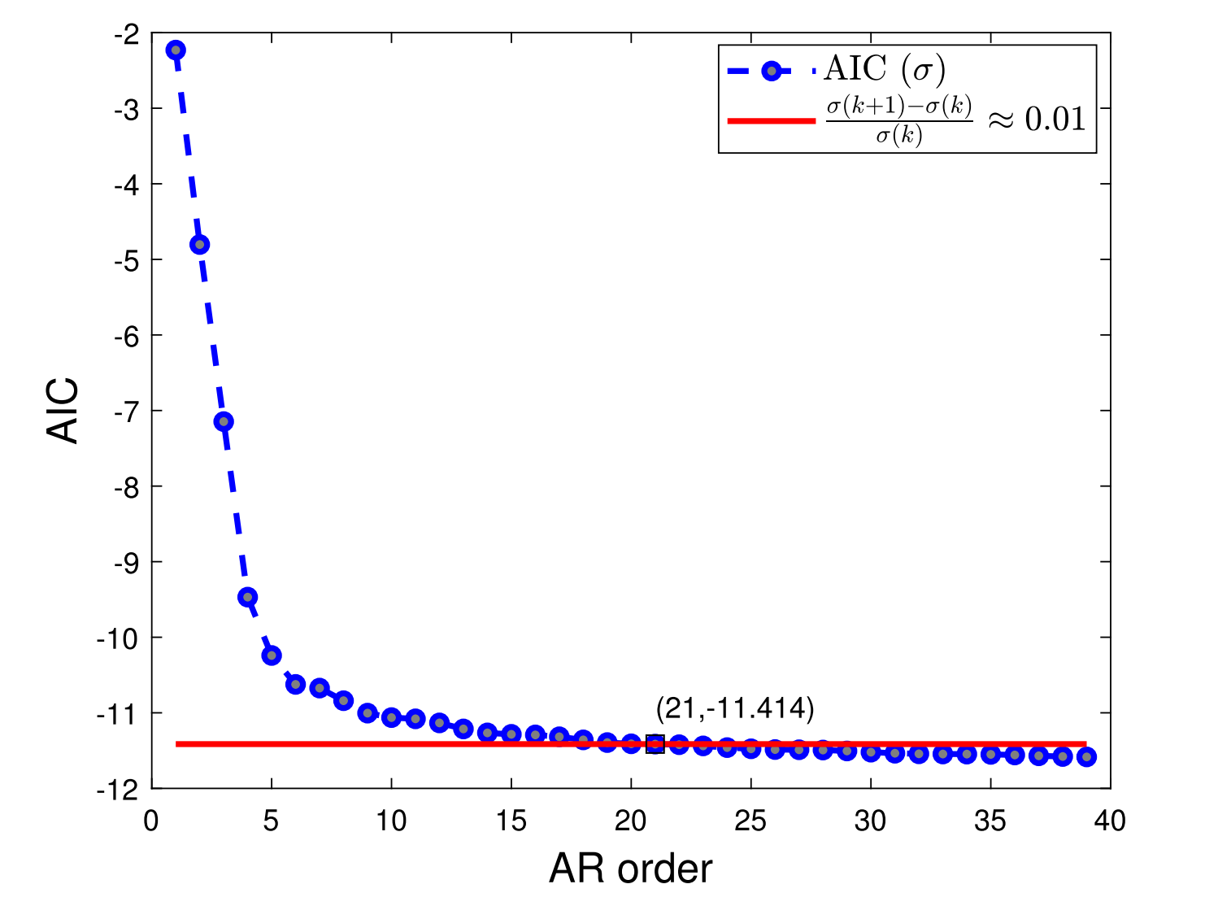
Order Of The AR [1]

Slide 16
Results (AR Model For Z)

Slide 17
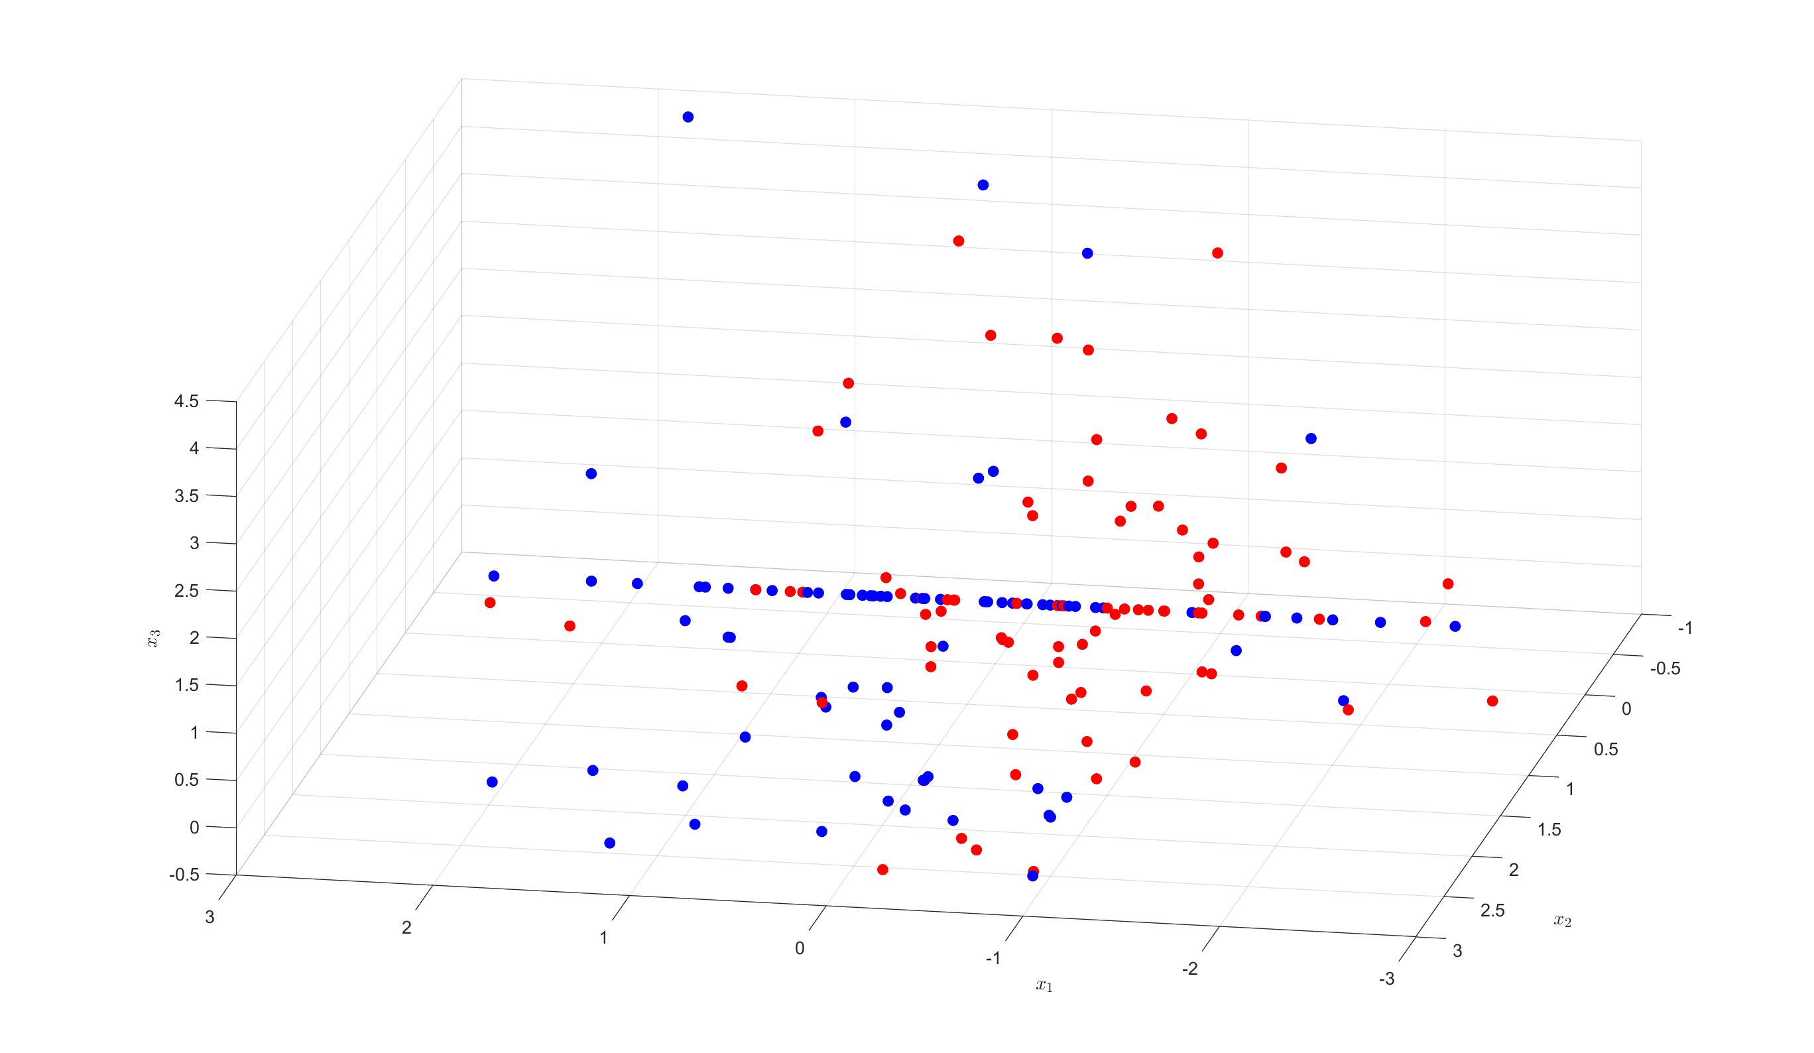
Results
Used AR Model For Z
Features:
Weights
Graph Frequencies (Eigen Values of Laplacian)
465 features
Chose 10 using mRMR
Classifier:
AdaBoost

Slide 18
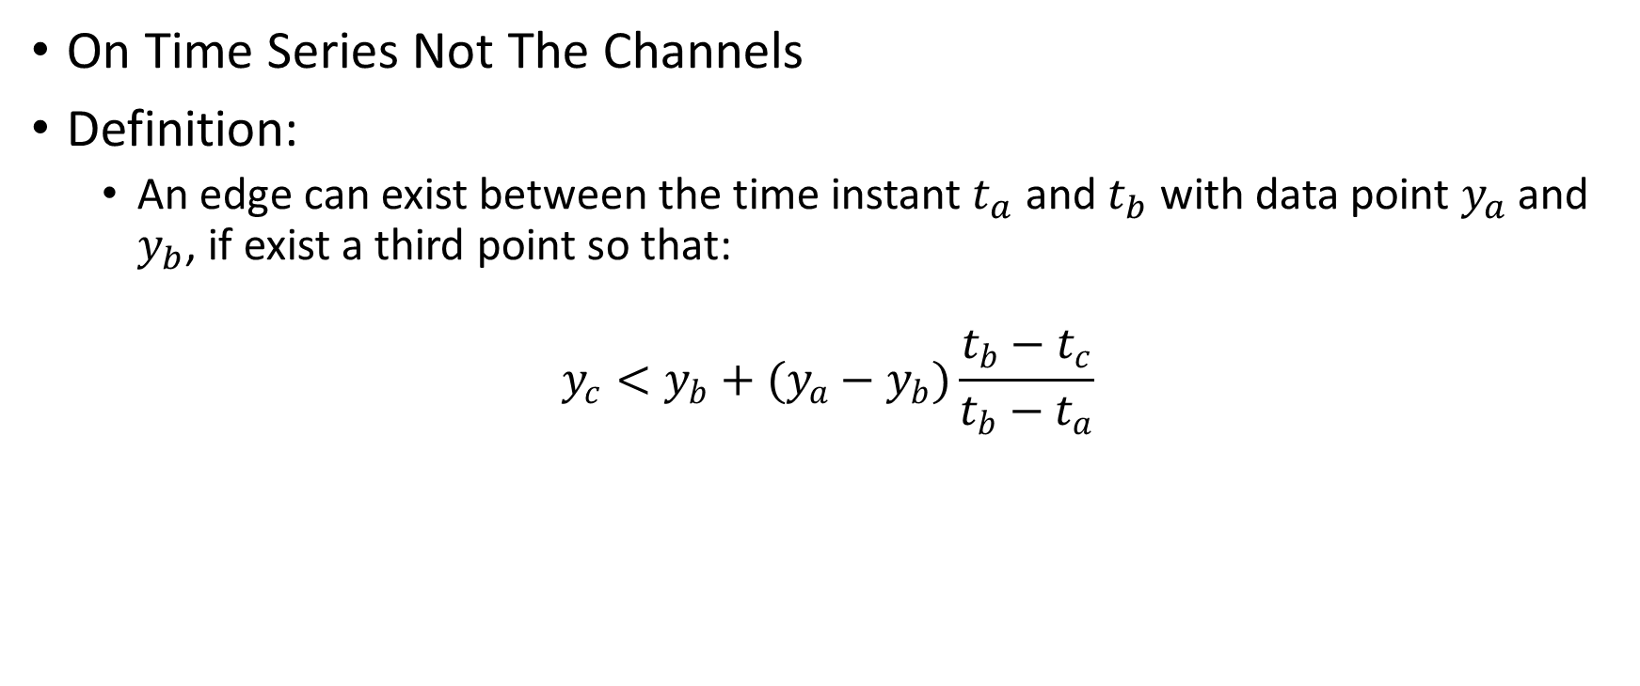
Morphological Approach [2]
On Time Series Not The Channels
Definition:
An edge can exist between the time instant $t_{a}$ and $t_{b}$ with data point $y_{a}$ and $y_{b}$, if exist a third point so that:
$$y_{c}<y_{b}+(y_{a}−y_{b})\frac{t_{b}−t_{c}}{t_{b}−t_{a}}$$

Slide 19
Definition

Slide 20
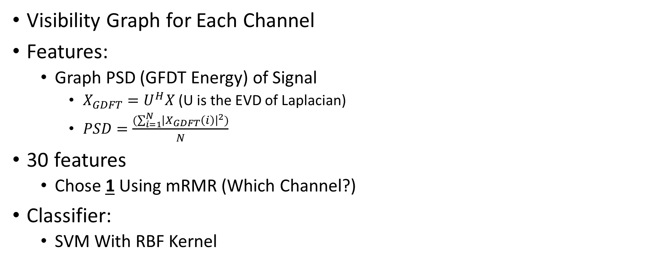
Results
Visibility Graph for Each Channel
Features:
Graph PSD (GFDT Energy) of Signal
$X_{GDFT}=U^{H}X$ (U is the EVD of Laplacian)
$PSD=\frac{(\sum_{i=1}^{N}{{\left|X_{GDFT}\left(i\right)\right|}^{2})}}{N}$
30 features
Chose 1 Using mRMR (Which Channel?)
Classifier:
SVM With RBF Kernel

Slide 21
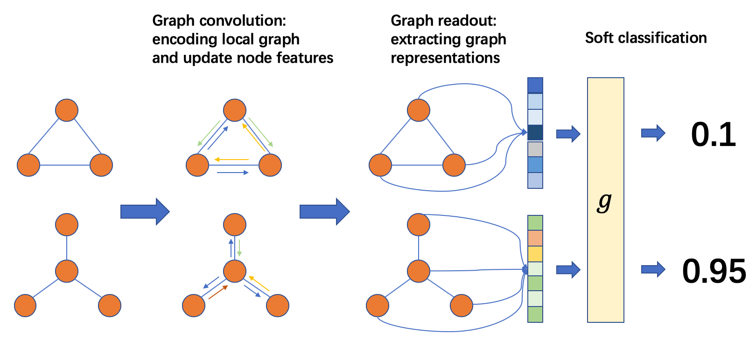
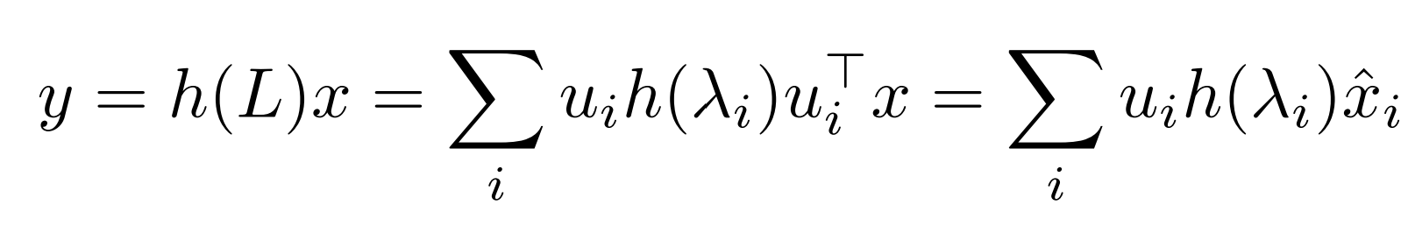

Graph Neural Network(GNN) [14][15][16]
Convolutional Neural Networks
Instead of multiplication they do filtering
We could do this filtering in Graph Domain

Slide 22
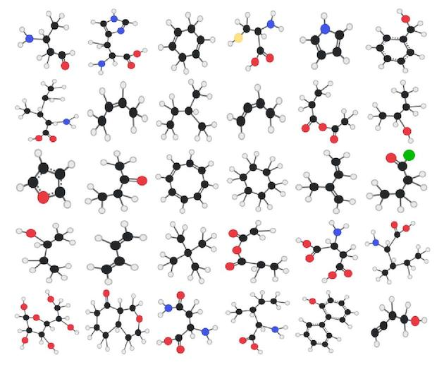
GNN
Convolutional Neural Networks in Graph Domain for Graph Classification
Pytorch Geometric

Slide 23
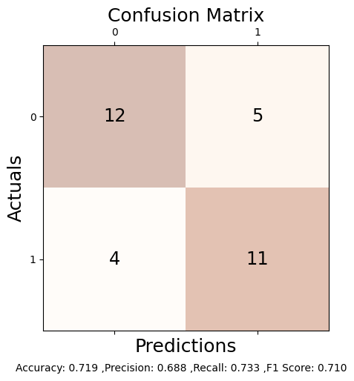
EEG-GNN
Edge and Node Features
Node:
Signal Itself
AR Model Coeff's
LSTM Embedding
Edge:
Physical Distance Electrodes
Euclidian Distance
Signal
AR
LSTM

Slide 24
References
Einizade, Aref, et al. "Neural decoding of imagined speech from EEG signals using the fusion of graph signal processing and graph learning techniques." Neuroscience Informatics 2.3 (2022): 100091. [1]
Mathur, Priyanka, and Vijay Kumar Chakka. "Graph signal processing of EEG signals for detection of epilepsy." 2020 7th International Conference on Signal Processing and Integrated Networks (SPIN). IEEE, 2020. [2]
Wendling, Fabrice, et al. "From EEG signals to brain connectivity: a model-based evaluation of interdependence measures." Journal of neuroscience methods 183.1 (2009): 9-18. [3]
Kalofolias, Vassilis. "How to learn a graph from smooth signals." Artificial Intelligence and Statistics. PMLR, 2016. [4]
López, Rafae Lemuz, et al. "Graph theory for brain connectivity characterization from EEG." 2020 10th International Symposium on Signal, Image, Video and Communications (ISIVC). IEEE, 2021. [5]
Mathur, Priyanka, and Vijay Kumar Chakka. "Graph signal processing based cross-subject mental task classification using multi-channel EEG signals." IEEE Sensors Journal 22.8 (2022): 7971-7978. [6]

Slide 25
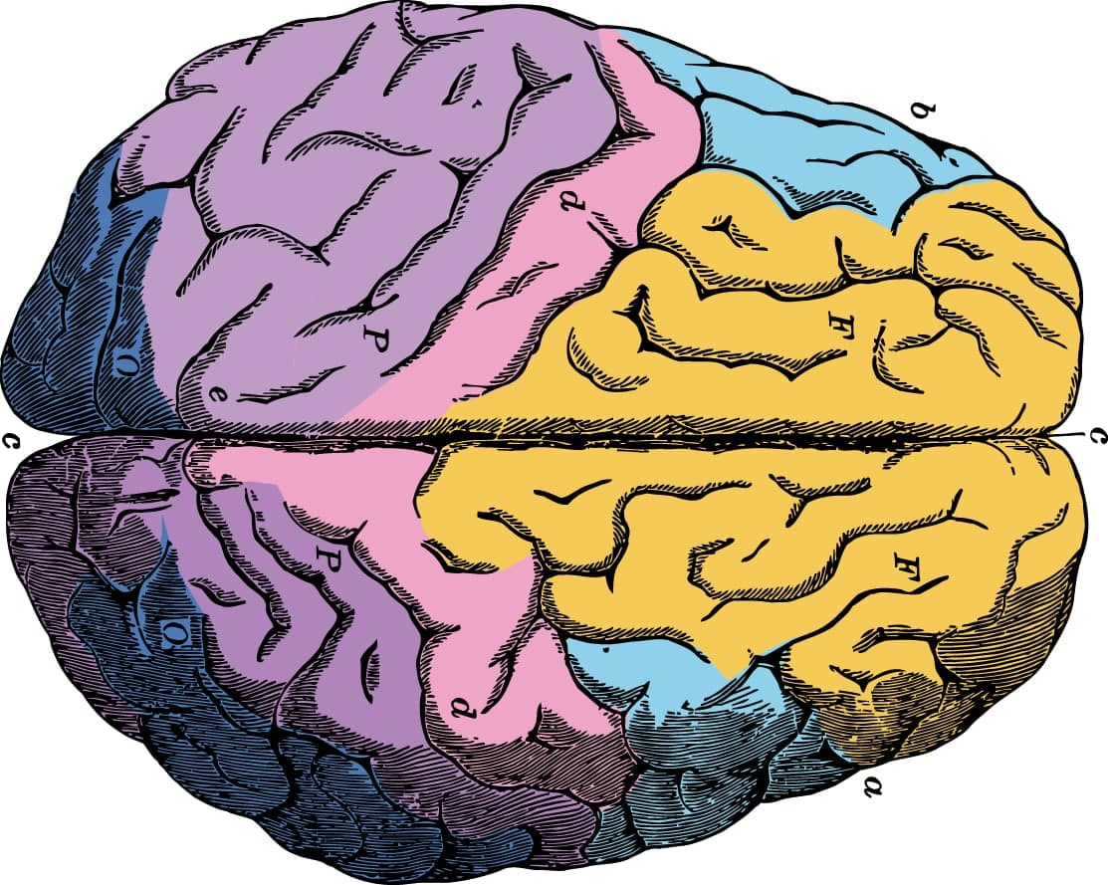
Thanks for Your Attention!

